Slide 1


http://www.comp.nus.edu.sg/~cs2100/
Recitation 1
C Programming, Data Representation and Number Systems

Slide 2
summary

Slide 3
1. A Simple C Program (3/3)
// Converts distance in miles to kilometres.
#include <stdio.h> /* printf, scanf definitions */
#define KMS_PER_MILE 1.609 /* conversion constant */
int main(void) {
float miles, // input – distance in miles
kms; // output – distance in kilometres
/* Get the distance in miles */
printf("Enter distance in miles: ");
scanf("%f", &miles);
// Convert the distance to kilometres
kms = KMS_PER_MILE * miles;
// Display the distance in kilometres
printf("That equals %9.2f km.\n", kms);
return 0;
}
standard header file
preprocessor directives
constant
reserved words
variables
comments
(Only /* … */ is ANSI C)
functions
special symbols
In C, semi-colon (;) terminates a statement.
Curly bracket { } indicates a block.
In Python: block is by indentation

Slide 4
4. Data Types (1/3)
float miles, kms;
Every variable must be declared with a data type
To determine the type of data the variable may hold
Basic data types in C:
int: For integers
4 bytes (in sunfire); -2,147,483,648 (-2³¹) through +2,147,483,647 (2³¹ – 1)
float or double: For real numbers
4 bytes for float and 8 bytes for double (in sunfire)
Eg: 12.34, 0.0056, 213.0
May use scientific notation; eg: 1.5e-2 and 15.0E-3 both refer to 0.015; 12e+4 and 1.2E+5 both refer to 120000.0
char: For characters
Enclosed in a pair of single quotes
Eg: 'A', 'z', '2', '*', ' ', '\n’
Python
JS
int
number
Python
JS
float
number
Python
JS
str
string

Slide 5
4. Data Types (2/3)
A programming language can be strongly typed or weakly typed
Strongly typed: every variable to be declared with a data type. (C: int count; char grade; )
Weakly typed: the type depends on how the variable is used (JavaScript: var count; var grade;)
The above is just a simple explanation.
Much subtleties and many views and even different definitions. Other aspects include static/dynamic type checking, safe type checking, type conversions, etc.
Eg: Java, Pascal and C are strongly typed languages. But Java /Pascal are more strongly typed than C, as C supports implicit type conversions and allows pointer values to be explicitly cast.
One fun video: https://www.youtube.com/watch?v=bQdzwJWYZRU

Slide 6
1. Data Representation (1/2)
Basic data types in C:
int
float
double
char
Variants: short, long
How data is represented depends on its type:
As an ‘int’, it is 70
01000110
As a ‘char’, it is ‘F’
11000000110100000000000000000000
As an ‘int’, it is -1060110336
As an ‘float’, it is -6.5

Slide 7
2. Decimal (base 10) Number System
A weighted-positional number system.
Base (also called radix) is 10
Symbols/digits = { 0, 1, 2, 3, 4, 5, 6, 7, 8, 9 }
Each position has a weight of power of 10
Eg: (7594.36)₁₀ = (7 × 10³) + (5 × 10²) + (9 × 10¹) + (4 × 10⁰) + (3 × 10⁻¹) + (6 × 10⁻²)
(a_{n}a_{n-1}… a₀ . f₁f₂ … f_{m})₁₀ = (a_{n} x 10^{n}) + (a_{n-1}x10^{n-1}) + … + (a₀ x 10⁰) + (f₁ x 10⁻¹) + (f₂ x 10⁻²) + … + (f_{m} x 10^{-m})

Slide 8
3. Other Number Systems (1/2)
Binary (base 2)
Weights in powers of 2
Binary digits (bits): 0, 1
Octal (base 8)
Weights in powers of 8
Octal digits: 0, 1, 2, 3, 4, 5, 6, 7.
Hexadecimal (base 16)
Weights in powers of 16
Hexadecimal digits: 0, 1, 2, 3, 4, 5, 6, 7, 8, 9, A, B, C, D, E, F.
Base/radix R:
Weights in powers of R

Slide 9
5. Decimal to Binary Conversion
For whole numbers
Repeated Division-by-2 Method
For fractions
Repeated Multiplication-by-2 Method

Slide 10
5.1 Repeated Divison-by-2
To convert a whole number to binary, use successive division by 2 until the quotient is 0. The remainders form the answer, with the first remainder as the least significant bit (LSB) and the last as the most significant bit (MSB).
(43)₁₀ = ( ? )₂
101011

Slide 11
5.2 Repeated Multiplication-by-2
To convert decimal fractions to binary, repeated multiplication by 2 is used, until the fractional product is 0 (or until the desired number of decimal places). The carried digits, or carries, produce the answer, with the first carry as the MSB, and the last as the LSB.
(0.3125)₁₀ = ( ? )₂
.0101

Slide 12
10.1 Sign-and-Magnitude (1/3)
The sign is represented by a ‘sign bit’
0 for +
1 for -
Eg: a 1-bit sign and 7-bit magnitude format.
sign
magnitude
00110100 ➔ +110100₂ = +52₁₀
10010011 ➔ -10011₂ = -19₁₀

Slide 13
10.1 Sign-and-Magnitude (2/3)
Largest value: 01111111 = +127₁₀
Smallest value: 11111111 = -127₁₀
Zeros: 00000000 = +0₁₀ 10000000 = -0₁₀
Range (for 8-bit): -127₁₀ to +127₁₀
Question:
For an n-bit sign-and-magnitude representation, what is the range of values that can be represented?

Slide 14
10.2 1s Complement (1/3)
Given a number x which can be expressed as an n-bit binary number, its negated value can be obtained in 1s-complement representation using:
-x = 2^{n} – x – 1
Example: With an 8-bit number 00001100 (or 12₁₀), its negated value expressed in 1s-complement is:
-00001100₂ = 2⁸ – 12 – 1 (calculation done in decimal) = 243 = 11110011_{1s}
(This means that -12₁₀ is written as 11110011 in 1s-complement representation.)

Slide 15
10.2 1s Complement (2/3)
Technique to negate a value: invert all the bits.
Largest value: 01111111 = +127₁₀
Smallest value: 10000000 = -127₁₀
Zeros: 00000000 = +0₁₀ 11111111 = -0₁₀
Range (for 8 bits): -127₁₀ to +127₁₀
Range (for n bits): -(2^{n-1} – 1) to 2^{n-1} – 1
The most significant bit (MSB) still represents the sign: 0 for positive, 1 for negative.

Slide 16
10.3 2s Complement (1/3)
Given a number x which can be expressed as an n-bit binary number, its negated value can be obtained in 2s-complement representation using:
-x = 2^{n} – x
Example: With an 8-bit number 00001100 (or 12₁₀), its negated value expressed in 2s-complement is:
-00001100₂ = 2⁸ – 12 (calculation done in decimal) = 244 = 11110100_{2s}
(This means that -12₁₀ is written as 11110100 in 2s-complement representation.)

Slide 17
10.3 2s Complement (2/3)
Technique to negate a value: invert all the bits, then add 1.
Largest value: 01111111 = +127₁₀
Smallest value: 10000000 = -128₁₀
Zero: 00000000 = +0₁₀
Range (for 8 bits): -128₁₀ to +127₁₀
Range (for n bits): -2^{n-1} to 2^{n-1} – 1
The most significant bit (MSB) still represents the sign: 0 for positive, 1 for negative.

Slide 18
Important!
10.4 Comparisons
4-bit system
Positive values Negative values
Value | Sign-and-Magnitude | 1s Comp. | 2s Comp.
+7 | 0111 | 0111 | 0111
+6 | 0110 | 0110 | 0110
+5 | 0101 | 0101 | 0101
+4 | 0100 | 0100 | 0100
+3 | 0011 | 0011 | 0011
+2 | 0010 | 0010 | 0010
+1 | 0001 | 0001 | 0001
+0 | 0000 | 0000 | 0000
Value | Sign-and-Magnitude | 1s Comp. | 2s Comp.
-0 | 1000 | 1111 | -
-1 | 1001 | 1110 | 1111
-2 | 1010 | 1101 | 1110
-3 | 1011 | 1100 | 1101
-4 | 1100 | 1011 | 1100
-5 | 1101 | 1010 | 1011
-6 | 1110 | 1001 | 1010
-7 | 1111 | 1000 | 1001
-8 | - | - | 1000

Slide 19
10.6 2s Complement on Addition/Subtraction (1/4)
Algorithm for addition of integers, A + B:
Perform binary addition on the two numbers.
Ignore the carry out of the MSB.
Check for overflow. Overflow occurs if the ‘carry in’ and ‘carry out’ of the MSB are different, or if result is opposite sign of A and B.
Algorithm for subtraction of integers, A – B: A – B = A + (-B)
Take 2s-complement of B.
Add the 2s-complement of B to A.

Slide 20
10.6 Overflow (2/4)
Signed numbers are of a fixed range.
If the result of addition/subtraction goes beyond this range, an overflow occurs.
Overflow can be easily detected:
positive add positive → negative
negative add negative → positive
Example: 4-bit 2s-complement system
Range of value: -8₁₀ to 7₁₀
0101_{2s} + 0110_{2s} = 1011_{2s} 5₁₀ + 6₁₀ = -5₁₀ ?! (overflow!)
1001_{2s} + 1101_{2s} = 10110_{2s} (discard end-carry) = 0110_{2s} -7₁₀ + -3₁₀ = 6₁₀ ?! (overflow!)

Slide 21
10.6 2s Complement Addition (3/4)
Examples: 4-bit system
+3 0011
+ +4 + 0100
---- -------
+7 0111
---- -------
-2 1110
+ -6 + 1010
---- -------
-8 11000
---- -------
No overflow
No overflow
+6 0110
+ -3 + 1101
---- -------
+3 10011
---- -------
+4 0100
+ -7 + 1001
---- -------
-3 1101
---- -------
No overflow
No overflow
-3 1101
+ -6 + 1010
---- -------
-9 10111
---- -------
+5 0101
+ +6 + 0110
---- -------
+11 1011
---- -------
Overflow!
Overflow!
Which of the above is/are overflow(s)?

Slide 22
10.7 1s Complement on Addition/Subtraction (1/2)
Algorithm for addition of integers, A + B:
Perform binary addition on the two numbers.
If there is a carry out of the MSB, add 1 to the result.
Check for overflow. Overflow occurs if result is opposite sign of A and B.
Algorithm for subtraction of integers, A – B: A – B = A + (-B)
Take 1s-complement of B.
Add the 1s-complement of B to A.

Slide 23
10.7 1s Complement Addition (2/2)
Examples: 4-bit system
+3 0011
+ +4 + 0100
---- -------
+7 0111
---- -------
+5 0101
+ -5 + 1010
---- -------
-0 1111
---- -------
No overflow
No overflow
-2 1101
+ -5 + 1010
---- -------
-7 10111
---- + 1
-------
1000
-------
-3 1100
+ -7 + 1000
---- -------
-10 10100
---- + 1
-------
0101
-------
No overflow
Overflow!
Any overflow?
DLD page 42 – 43 Quick Review Questions Questions 2-13 to 2-18.

Slide 24
10.8 Excess Representation (2/2)
Example: For 4-bit numbers, we may use excess-7 or excess-8. Excess-8 is shown below.
Excess-8 Representation | Value
0000 | -8
0001 | -7
0010 | -6
0011 | -5
0100 | -4
0101 | -3
0110 | -2
0111 | -1
Excess-8 Representation | Value
1000 | 0
1001 | 1
1010 | 2
1011 | 3
1100 | 4
1101 | 5
1110 | 6
1111 | 7

Slide 25
11.2 IEEE 754 Floating-Point Rep. (3/4)
3 components: sign, exponent and mantissa (fraction)
sign
exponent
mantissa
Sign bit: 0 for positive, 1 for negative.
Mantissa is normalised with an implicit leading bit 1
110.1₂ → normalised → 1.101₂ × 2² → only 101 is stored in the mantissa field
0.00101101₂ → normalised → 1.01101₂ × 2^{–3} → only 01101 is stored in the mantissa field

Slide 26
11.2 IEEE 754 Floating-Point Rep. (4/4)
Example: How is –6.5₁₀ represented in IEEE 754 single-precision floating-point format?
-6.5₁₀ = -110.1₂ = -1.101₂ × 2²
Exponent = 2 + 127 = 129 = 10000001₂
1
10000001
10100000000000000000000
sign
exponent
(excess-127)
mantissa
We may write the 32-bit representation in hexadecimal:
1 10000001 10100000000000000000000₂ = C0D00000₁₆
(Slide 4)
11000000110100000000000000000000
As an ‘int’, it is -1060110336
As an ‘float’, it is -6.5

Slide 27
Quiz solutions

Slide 28
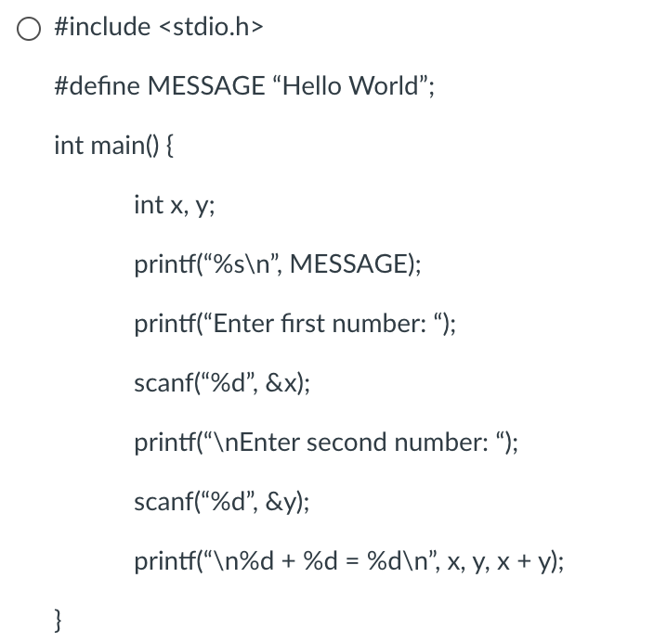
Programming Quiz 1
Q1: Which of the following is a valid, complete C Program?

Slide 29
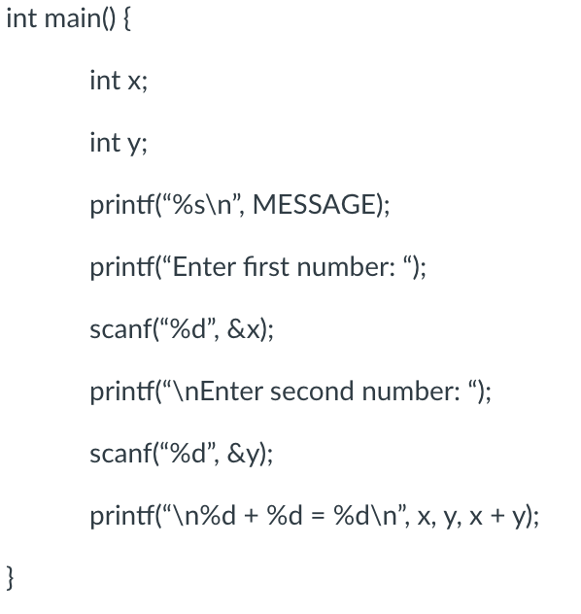
Programming Quiz 1
Q1: Which of the following is a valid, complete C Program?

Slide 30
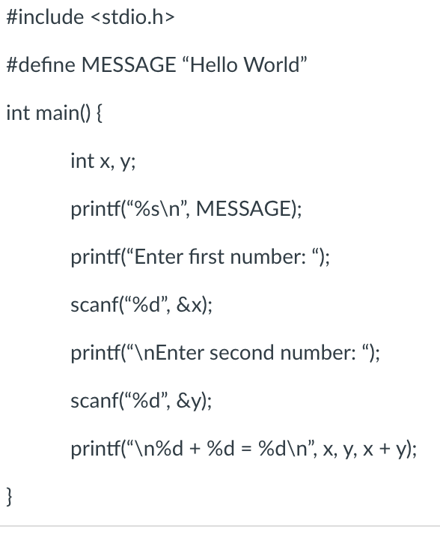
Programming Quiz 1
Q1: Which of the following is a valid, complete C Program?
CORRECT ANSWER

Slide 31
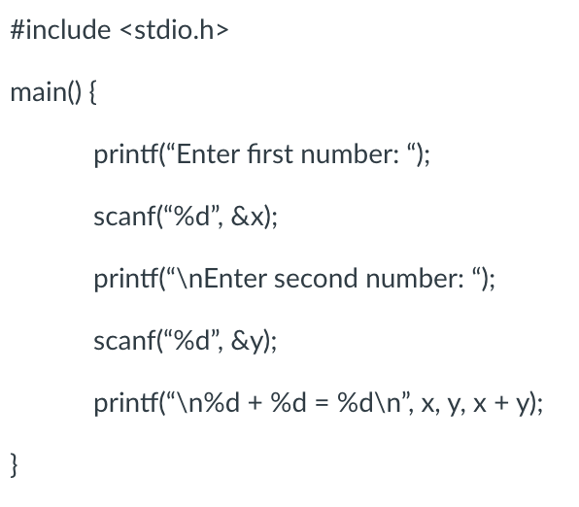
Programming Quiz 1
Q1: Which of the following is a valid, complete C Program?

Slide 32
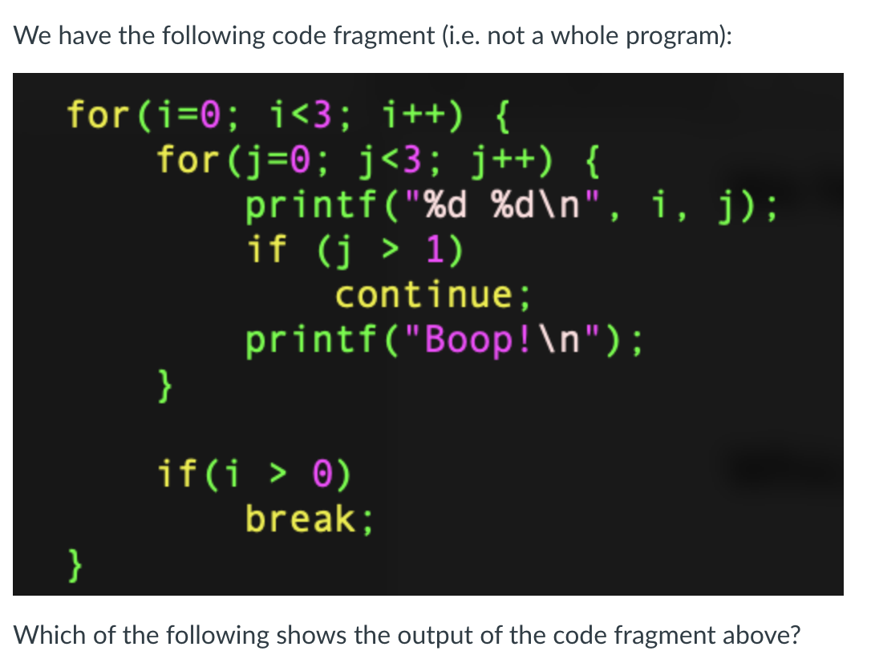
Programming Quiz 2
Q1:

Slide 33
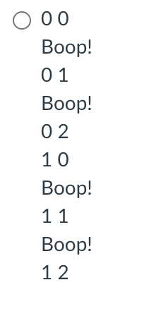
Programming Quiz 2
Q1:
CORRECT ANSWER

Slide 34
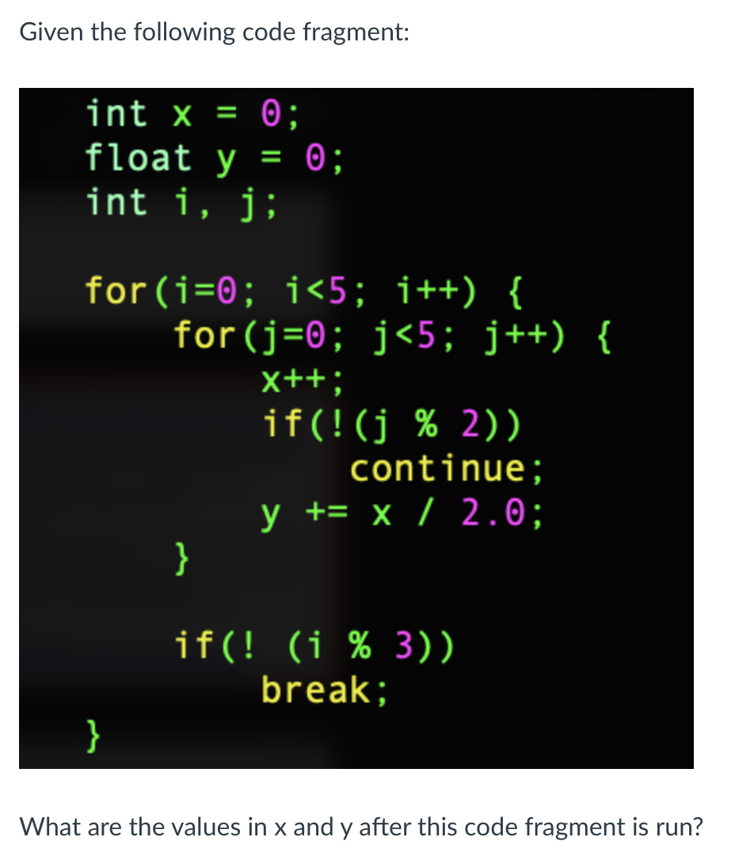
Programming Quiz 2
Q2:

Slide 35

Programming Quiz 2
Q1:
CORRECT ANSWER

Slide 36
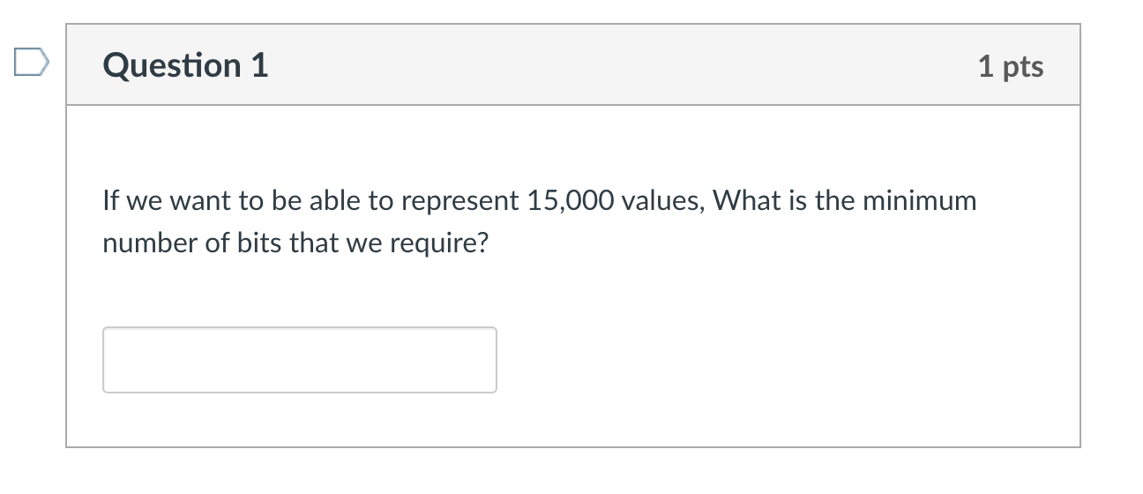
Number Systems Quiz 1
Q1:

Slide 37
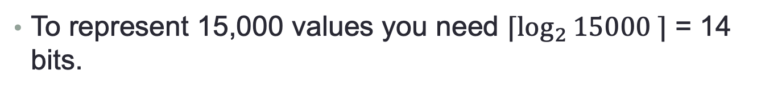
Number Systems Quiz 1
To represent 15,000 values you need $⌈\log_{2}{15000 ⌉}$ = 14 bits.

Slide 38
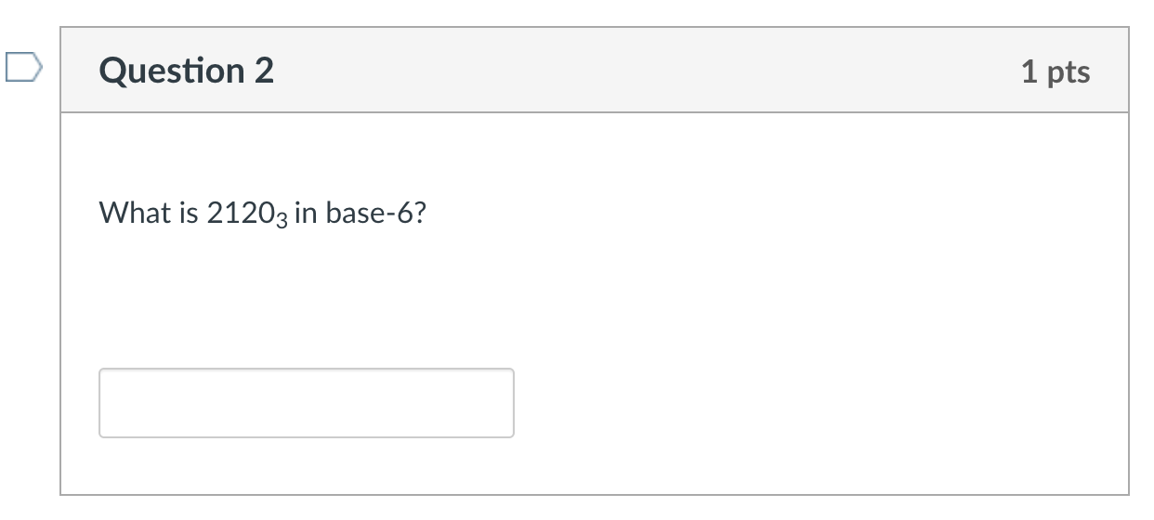
Number Systems Quiz 1
Q1:

Slide 39

Number Systems Quiz 1
Rule: Step 1 Convert from base-3 to base-10.
$${2120}_{3}=2×3^{3}+1×3^{2}+2×3^{1}+0×3^{0}$$
$$=2×27+1×9+2×3+0 ×1$$
$$={69}_{10}$$

Slide 40
Number Systems Quiz 1
Rule: Step 2 Convert from base-10 to base-6.
${69}_{10}=__×6^{3}$+$__×6^{2}+__×6^{1}+__×6^{0}$
$${69}_{10}=0×6^{3}+1×6^{2}+5×6^{1}+3×6^{0}$$
$$={153}_{6}$$

Slide 41
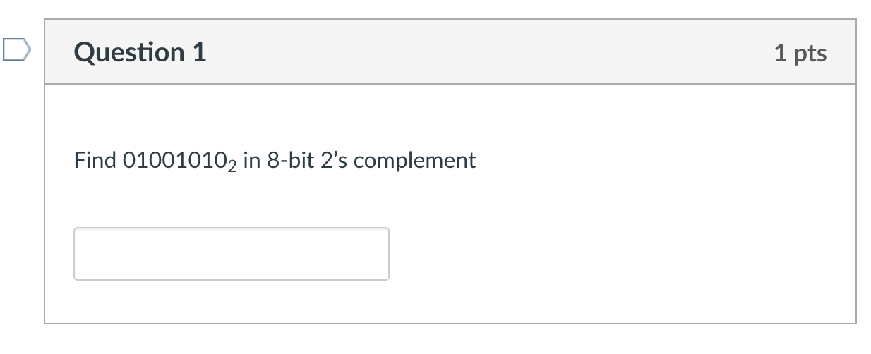
Number Systems Quiz 2

Slide 42
Number Systems Quiz 2
Remember: 2’s complement is a REPRESENTATION, not an OPERATION.
You perform the “invert everything and plus 1” operation only when converting from positive to negative and vice-versa.
Answer: ${01001010}_{2}$

Slide 43
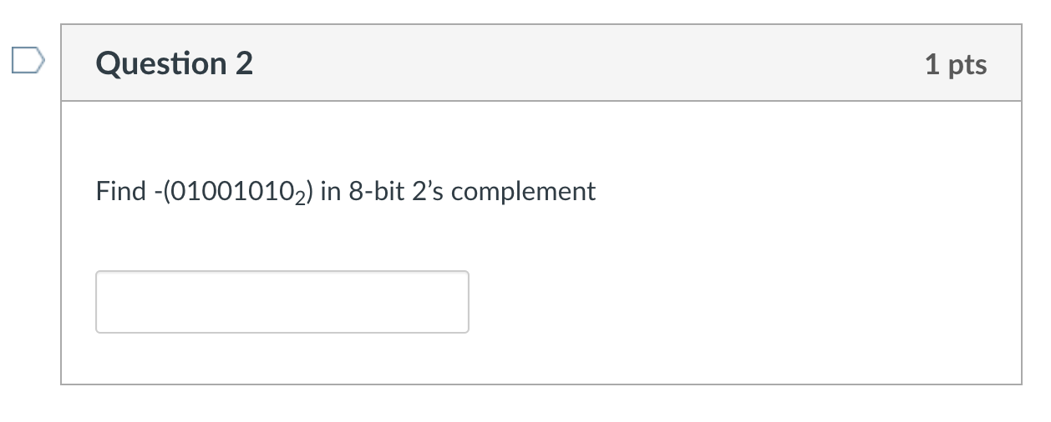
Number Systems Quiz 2

Slide 44
Number Systems Quiz 2
Here we are negating 01001010₂ . So we invert everything and add 1.
Invert everything: 10110101₂
Add one: 10110110_{2s}

Slide 45
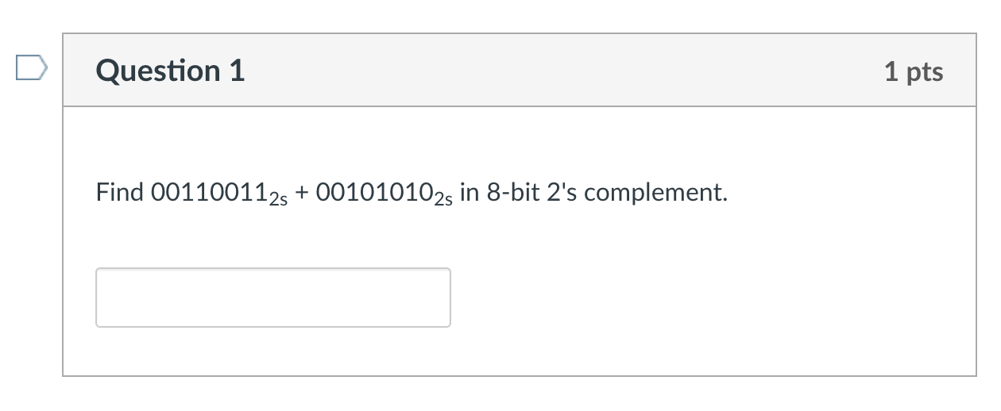
Number Systems Quiz 3

Slide 46
Number Systems Quiz 3

Slide 47
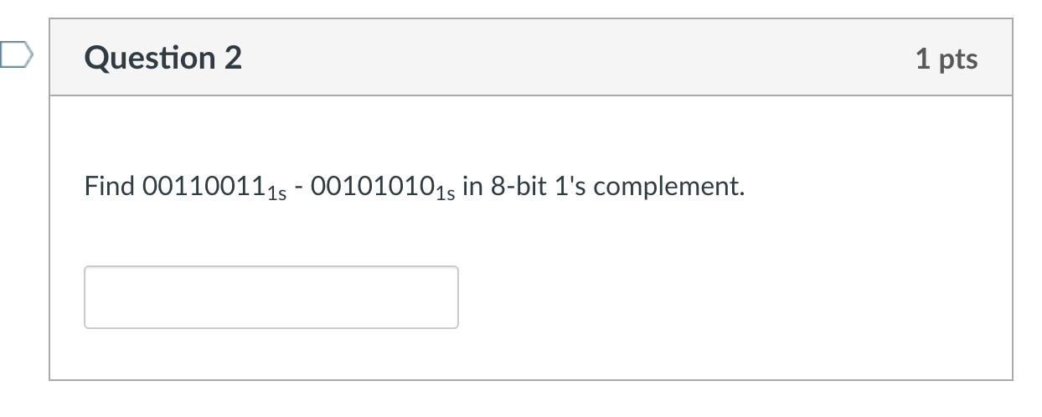
Number Systems Quiz 3

Slide 48
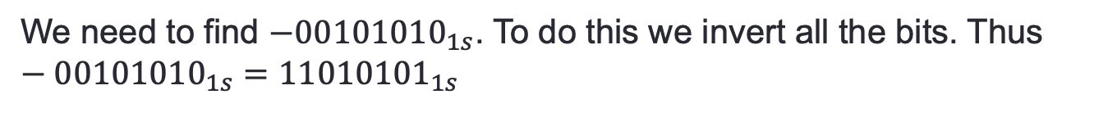
Number Systems Quiz 3
${00110011}_{1s}−{00101010}_{1s}={0011011}_{1s}+(−{00101010}_{1s})$
We need to find $−{00101010}_{1s}$. To do this we invert all the bits. Thus $−{00101010}_{1s}={11010101}_{1s}$

Slide 49
Number Systems Quiz 3
So ${00110011}_{1s}−{00101010}_{1s}={0011011}_{1s}+{11010101}_{1s}$

Slide 50
Number Systems Quiz

Slide 51
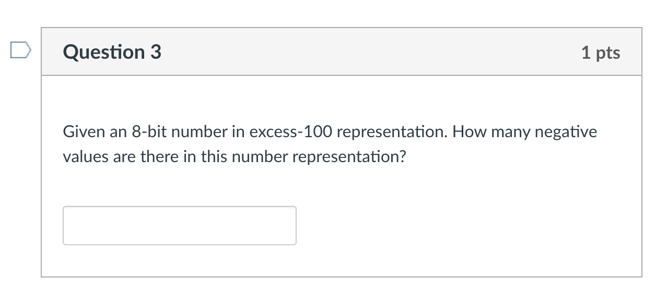
Number Systems Quiz 3

Slide 52
Number Systems Quiz 3
Excess-100 means that we add 100 to the number we want to represent in binary. I.e. if we wanted to represent x in excess-100, we would represent x+100 in binary.
Smallest number you can represent in 8-bit binary is 00000000₂ = 0. Therefore the most negative value x that you can represent is x + 100 = 0, or x=-100.
The number of negative values is then -100 to -1, which is 100 negative values.

Slide 53
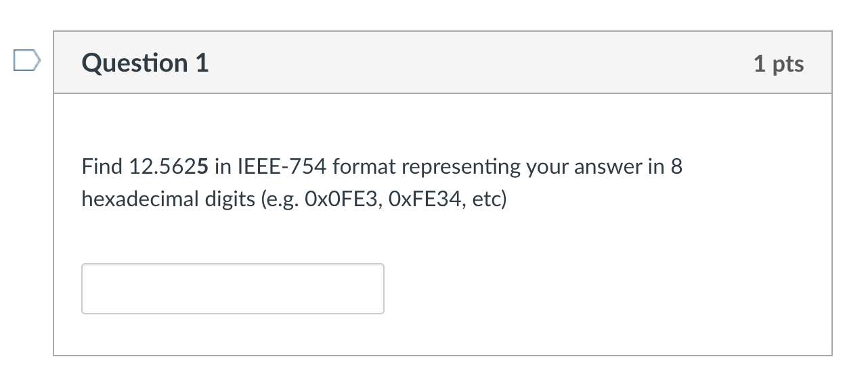
Number Systems Quiz 4

Slide 54
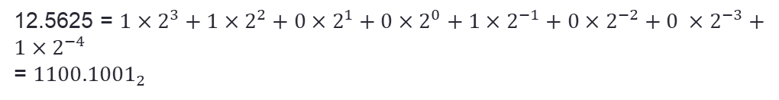
Number Systems Quiz 4
12.5625 = $1×2^{3}+1×2^{2}+0×2^{1}+0×2^{0}+1×2^{−1}+0×2^{−2}+0 ×2^{−3}+1×2^{−4}$
= ${1100.1001}_{2}$
Normalize:
$${1100.1001}_{2}=1.1001001×2^{3}$$
Exponent: $3+127=130=128+2= 1×2^{7}+0×2^{6}+0×2^{5}+0×2^{4}+0×2^{3}+0×2^{2}+1×2^{1}+0×2^{0}$
= ${10000010}_{2}$

Slide 55
Number Systems Quiz 4
Mantissa: ${1.1001001}_{2}$. We drop the leading 1 (hidden bit), giving us ${1001001}_{2}$
Pad to 23 bits:
$$10010010000000000000000$$
Sign bit: 0 (since positive). Stick sign bit + exponent bits + mantissa bits
$$0 10000010 {10010010000000000000000}_{2}$$
Split into groups of 4 bits (right to left):$0100 0001 0{100 1001 0000 0000 0000 0000}_{2}$
Translate to hex: $4149{0000}_{16}$

Slide 56
Sli.do questions

Slide 57
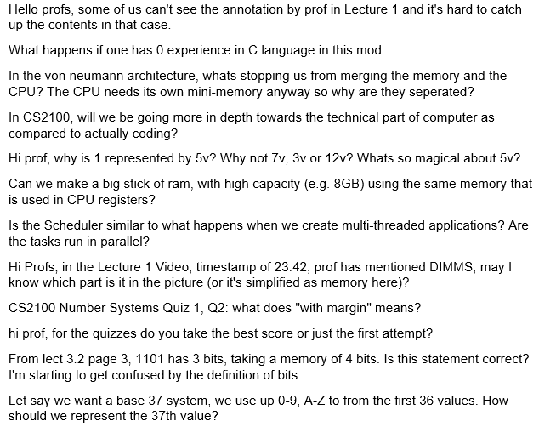
General Questions

Slide 58
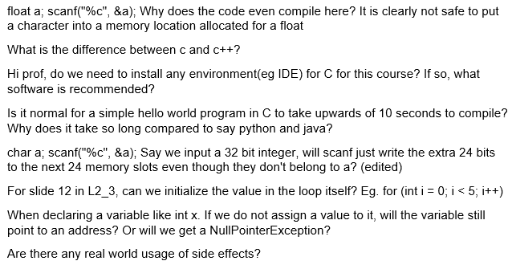
C Programming

Slide 59

Basic Number Systems

Slide 60
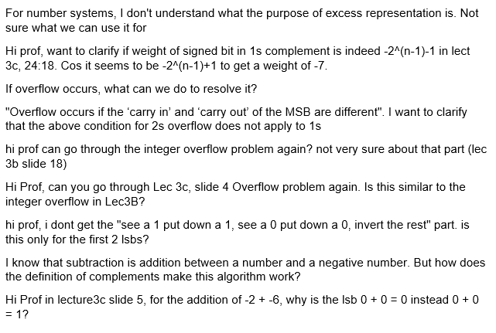
Negative Numbers

Slide 61
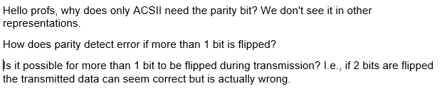
ASCII

Slide 62
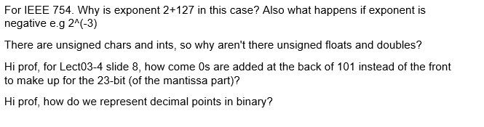
Fixed and Floating Point Numbers

Slide 63
extra exercises

Slide 64
Extra Exercises Exercise 1 – Simple Calculator
Write a program that:
Asks for an operator (+, -, *, / or q).
If the operator is +, -, * or /, ask for two floating point numbers.
Prints “Unrecognized operation” if the operator entered is not +, -, *, / or q.
If the person enters ”q” the program says “Bye!” and exits. If the user enters +, -, *, /, the program performs the operation on the two numbers entered and prints the result in two decimal places.
If the user did not enter “q”, go to 1.
The next slide shows some sample runs.

Slide 65
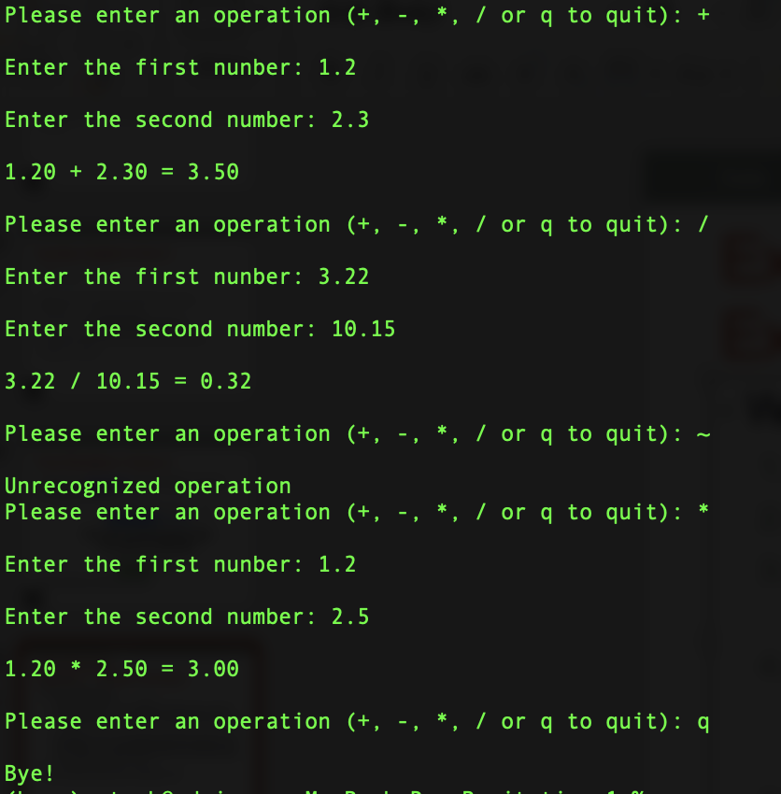
Extra Exercises Exercise 1 – Simple Calculator

Slide 66
Extra Exercises Exercise 2 – Number Systems
Using what you know about number systems and C, show why this while loop may never end: float x = 0.0; while(x != 1.0) x += 0.1;

Slide 67
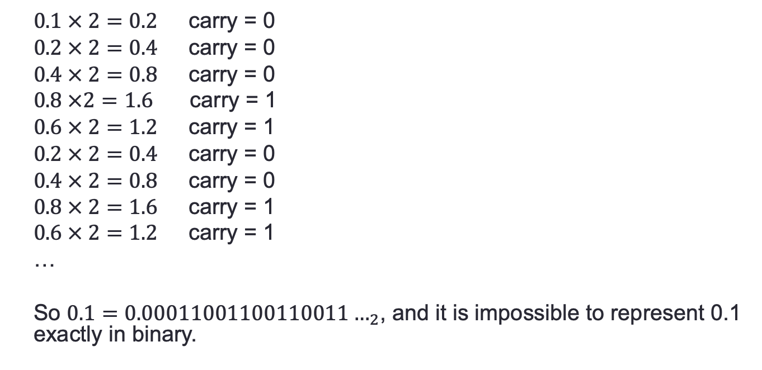
Extra Exercises Exercise 2 – Number Systems
Let’s convert 0.1 to binary:
$0.1 × 2=0.2$ carry = 0
$0.2 × 2=0.4$ carry = 0
$0.4 × 2=0.8$ carry = 0
$0.8 ×2=1.6$ carry = 1
$0.6 × 2=1.2$ carry = 1
$0.2 × 2=0.4$ carry = 0
$0.4 × 2=0.8$ carry = 0
$0.8 × 2=1.6$ carry = 1
$0.6 × 2=1.2$ carry = 1
…
So $0.1=0.00011001100110011…_{2}$, and it is impossible to represent 0.1 exactly in binary.

Slide 68
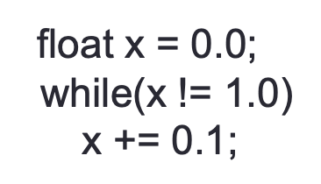
Extra Exercises Exercise 2 – Number Systems
If we used 32 bits to represent 0.1, the closest we would get is 0.0999999998603016.
After adding 10 of these, would get 0.99999999860316.
After adding again, we would get 1.09999999846332. I.e. x will never become 1 and the loop will never terminate.
Note: IEEE-754 format uses only 23 bits for the mantissa and would be even less accurate.

Slide 69
End of File

